Slide 1
Introduction OpenCV
Anuj Jain

Slide 2
Introduction
OpenCV is an Image Processing library created by Intel and maintained by Willow Garage.
Available for C, C++, and Python
Newest update is version 4.0
Open Source and free
Easy to use and install

Slide 3
Installation Steps
Following software's are to be installed in the sequence as given below:
python (ver. 3.5 or 3.6 preferably):
Numpy
Pandas
Scipy
Matplotlib
Opencv
Ubuntu installation
sudo add-apt-repository ppa:jonathonf/python-3.6
sudo apt update
sudo apt install python3.6
sudo apt install python3-numpy
sudo apt install python3-scipy
sudo apt install python3-pandas
sudo apt install python3-matplotlib
sudo apt install python3-pip
pip3 install opencv-python

Slide 4
Contd..
Window Installation
pip install numpy
pip install pandas
pip install scipy
pip install sklearn
pip install matplotlib
pip install opencv-python

Slide 5
Basic Operations on Images
Access pixel values and modify them
Access image properties
Setting Region of Image (ROI)
Splitting and Merging images

Slide 6
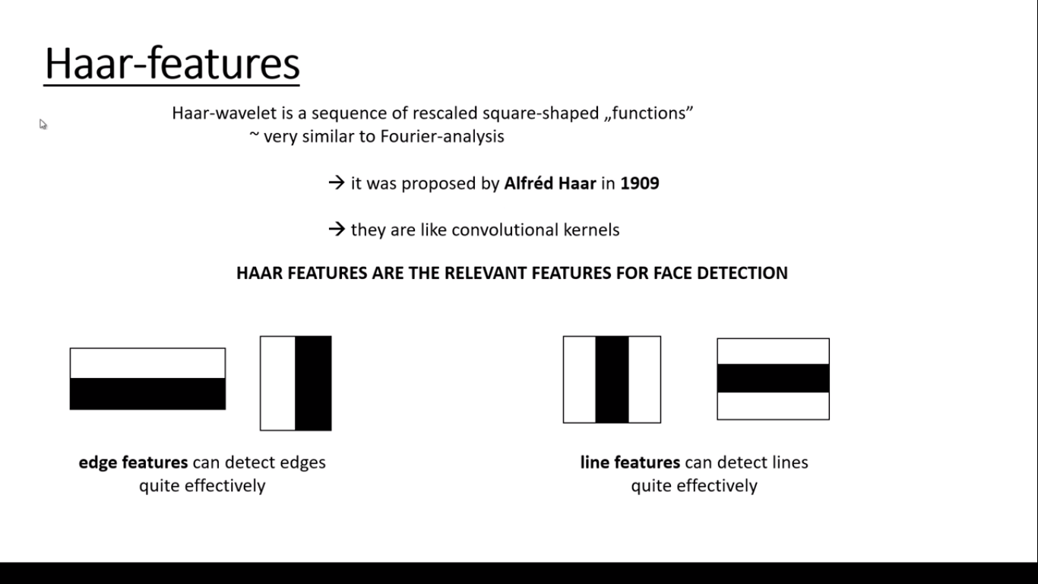

Slide 7


Slide 8
